Slide 1
Out-Groups and Threats as a Foundation for Terrorist Rhetoric
A Natural Language Processing Based Sociopsychological Analysis of ISIS’s Al-Naba Magazine

Slide 2
Social Identity Theory
The theory is the brainchild of a, UK based, Polish psychologist, Henry Tajfel in 1978 (Colman, 2015)
“Findings from SIT suggest that identities are not only driven by social categories (i.e. religion or nationality), but are also negotiated and redefined on the community level. On the one hand, identities are formed in response to contextual and social stimuli and cues. On the other, the cognitive frameworks that define the various groups and networks in which the individual interacts have a significant impact on what s/he perceives, as well as consequent behaviour.” (Raffie, 2013, p. 89)
“A social psychological theory of identity formation that privileges the role of large group identities in forming individuals' concepts of self. It has been used, in particular, to examine the formation and forms of adherence to national and (Calhoun, 2002)

Slide 3
Integrated Threat Theory
Diagram: A casual model of the integrated threat theory
Realistic threats are those that jeopardise the economic or political status, pose an existential or material threat to the group. This threat can be either objective or subjective; the perception of the threat is sufficient for prejudice to take place.
Symbolic threats shake the group’s perception of the world, jeopardising the group’s belief in the validity of its values. These threats are perceived as differences in morals, values, beliefs and/or attitudes. The two scholars saw that these kinds of threats are causes of prejudice, not a form of it.
Intergroup anxiety is the personal threats perceived by the individual as a result of interacting with the other, i.e. fears of rejection, embarrassment, or ridicule. Negative stereotypes, on the other hand, lead the individual affected to presume unfavourable treatments from the group holding these stereotypes.
Realistic Threats
Symbolic Threats
Intergroup Conflict
Status Inequalities
Ingroup Identification
Knowledge
Contact
Intergroup Anxiety
Negative Stereotyping
Prejudice
Behavior

Slide 4
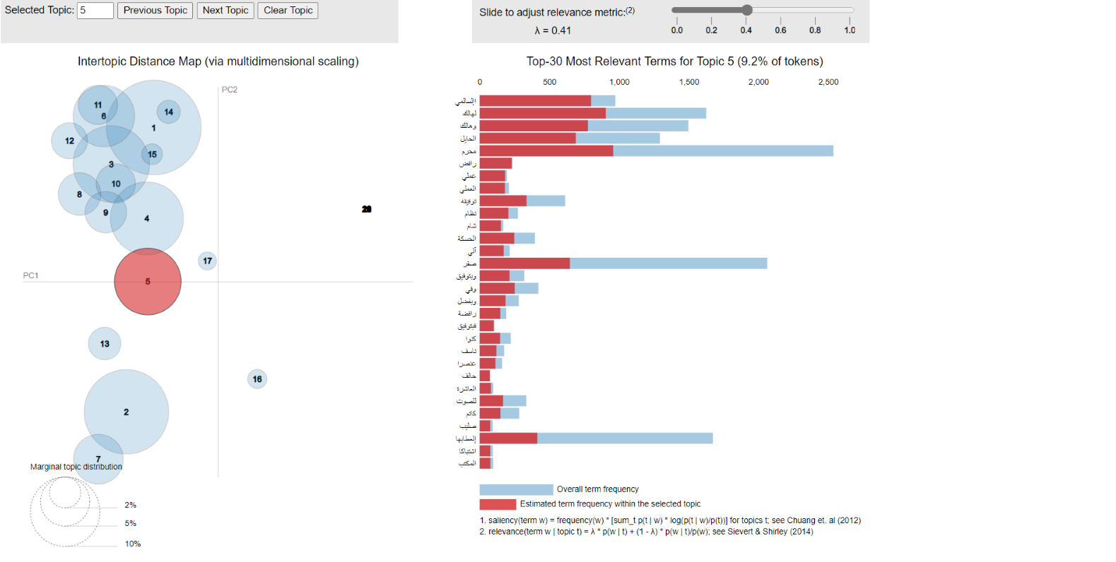
Topic Models: Shias as the enemy
Rafid (Shia/Alawite)
Political Regime
Rafid (Shia/Alawite)
Explosive
Cross
Skirmishes

Slide 5
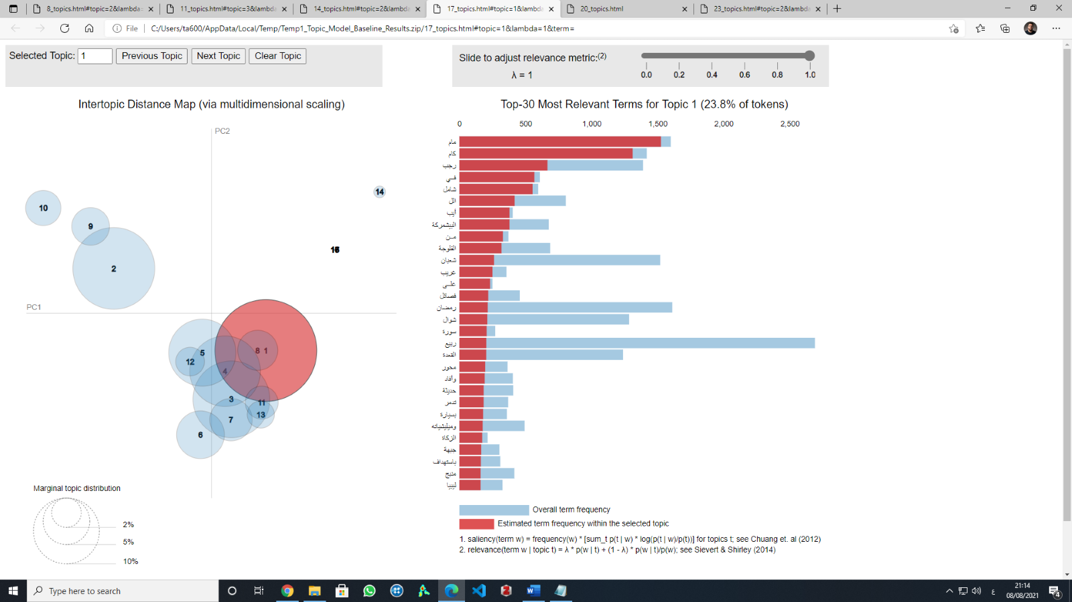
Topic Models: Peshmerga as the Enemy
Peshmerga
Brigades
Destroys
Its Militias
War Front
To Target

Slide 6
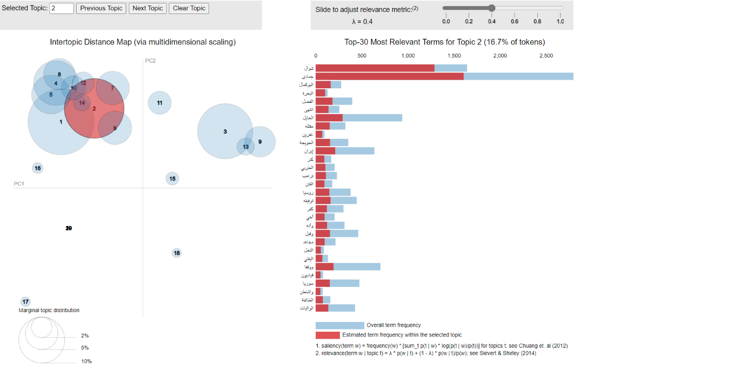
Topic Models: Various Enemies (Iran, Trump, Russia, Syria, Washington)
Murder
Iran
Trump
Disorder/ Causing Chaos
Russia
Kufr (Blasphemy)
Mujahid
Leaders
Syria
Washington

Slide 7
Integrated Threat Theory
Diagram: A casual model of the integrated threat theory
Realistic threats are those that jeopardise the economic or political status, pose an existential or material threat to the group. This threat can be either objective or subjective; the perception of the threat is sufficient for prejudice to take place.
Symbolic threats shake the group’s perception of the world, jeopardising the group’s belief in the validity of its values. These threats are perceived as differences in morals, values, beliefs and/or attitudes. The two scholars saw that these kinds of threats are causes of prejudice, not a form of it.
Intergroup anxiety is the personal threats perceived by the individual as a result of interacting with the other, i.e. fears of rejection, embarrassment, or ridicule. Negative stereotypes, on the other hand, lead the individual affected to presume unfavourable treatments from the group holding these stereotypes.
Realistic Threats
Symbolic Threats
Intergroup Conflict
Status Inequalities
Ingroup Identification
Knowledge
Contact
Intergroup Anxiety
Negative Stereotyping
Prejudice
Behavior

Slide 8
Challanges of Arabic NLP
Applying NLP to Arabic text data comes with and technical and language specific challenges:
Most of the main NLP Frameworks do not support the Arabic language (no Sentiment Analysis, NER, POS, ect.) -> preprocessing complex and demanding
Working Frameworks sometimes show buggy behavior (Parser -> mirroring of words)
Specific unusual usage of language by sub-group (ISIS) -> interpretation of results are more difficult

Slide 9
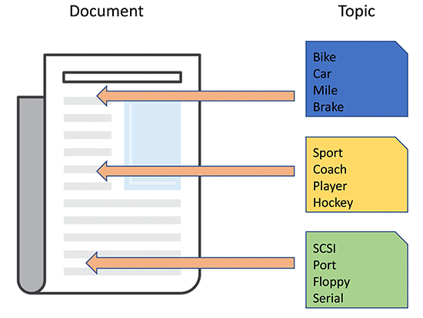
Topic Modelling: LDA
The concept of Latent Dirichlet Allocation
In NLP, a Topic Model is a statistical model for detecting the abstract "topics" that occur in a corpus of documents. Topic modeling is a commonly used text mining tool for discovering hidden semantic structures in a body of text.
LDA is a specific type of topic Model where the assumption is that each document can be described by a distribution of topics and each topic can be described by a distribution of words
These distributions are assumed to be described by a Dirichlet distribution.
In simple terms: An algorithm is approximating the distribution over the topics and the distribution over the words for the input corpus to create the results that we saw earlier.

Slide 10
Process Overview
A NLP pipeline step-by-step
Basic Processing
Parse PDFs
283 issues, Oct 15 – Mar 21
Several PDF-Parsers compared
Simple text data preprocessing
Removal: control characters, punctuation, numbers…
Date insertation, tokenization, Word mirroring
Removal of stop-words
NLTKs Arabic stop-word dictionary
Not satisfactory – adjusted by hand
Case Specific Preprocessing
Final preprocessed data
Data ready for analysis
Comparance against Alittihad newspaper corpus
Assure that wrongly parsed words are removed
Hand-selected most occuring words
Check the 500 most occuring words from the original data to not remove ISIS-specific words

Slide 11
Process Overview
A NLP pipeline step-by-step
Final preprocessed data
Data ready for analysis
Quantitative NLP Analysis
Analysis of words surrounding the Outgroups
20 left, 20 right
Human interpretation of Sentiments
Outgroups
Yazidis, Jews, “ Westerns“, Alewites, Kurds…
LDA
Issue: many topics overlap
→ @Talip: Arabic: many double entendres?
Planned: Comparance against occurance of terrorist attacks
Correlation
Prediction based of Outgroups mentioning or sentiment
Count of Outgroup mentions over time
Monthly
Planned: weekly
Overview about the topics discussed in the Newsletters
Summary of Contents
@Talip: What else can we see?
11

